Slide 1
A Dynamic Visualization Tool for the Analysis of SPIKE Scheduling Constraints
Leah Fulmer
Mark Giuliano
STScI Space Astronomy Summer Program
August 7th, 2017

Slide 2
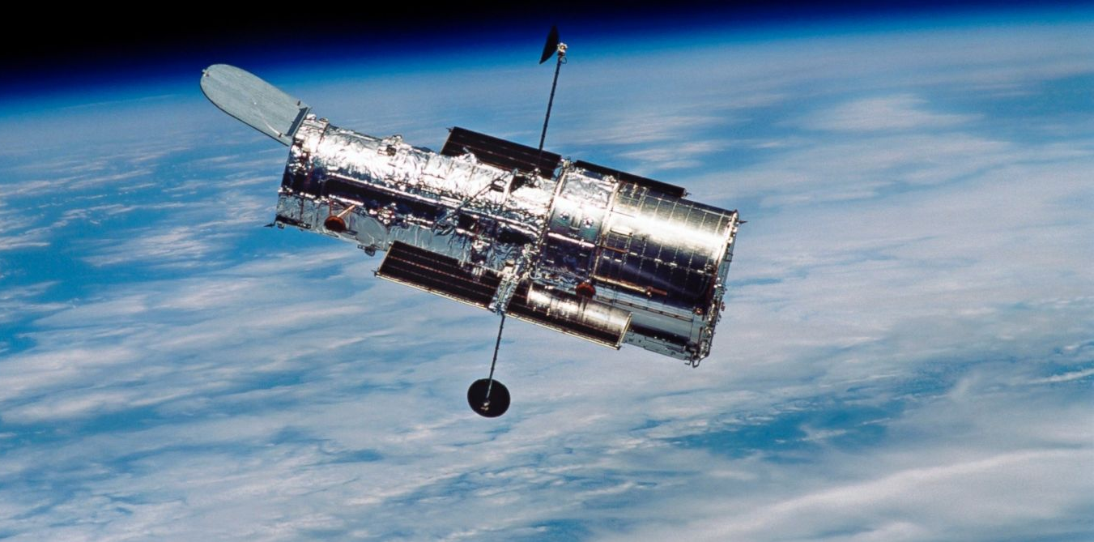
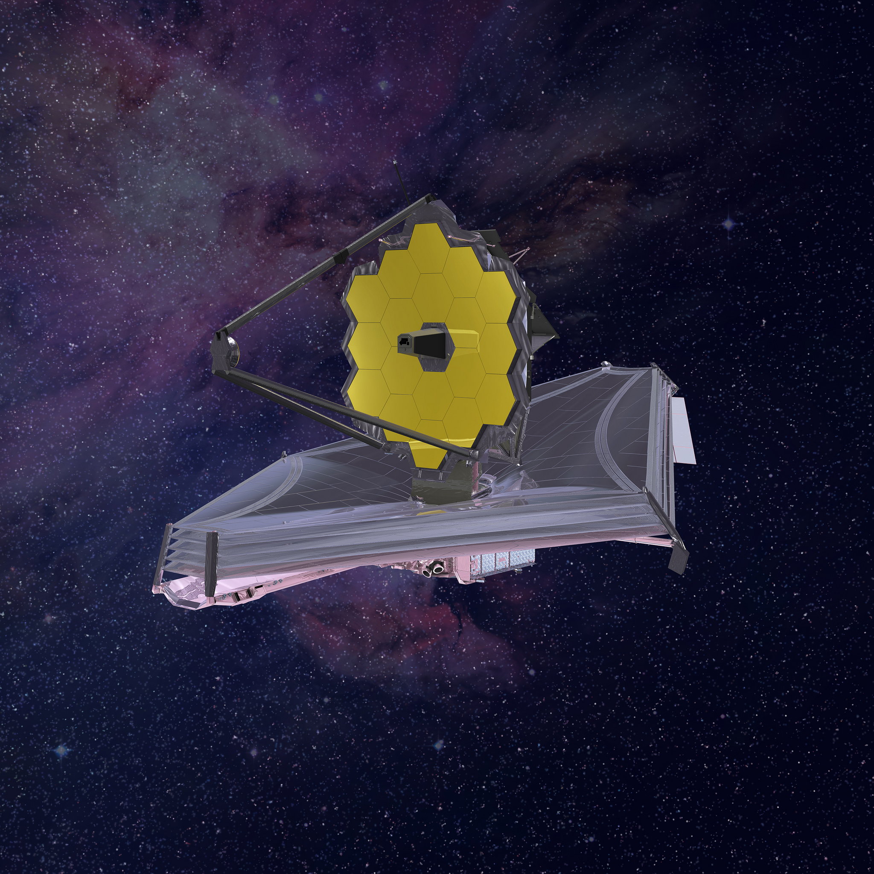
SPIKE
Long-range planning system used to schedule observations made with HST and JWST
STScI Space Astronomy Summer Program August 7th, 2017

Slide 3
Piecewise Constant Functions
Represent the schedulability of a particular observation based on both the target’s constraints and those of the telescope
Written as a list of time-value pairs: (t₁, v₁, t₂, v₂, …, t_{n}, v_{n})
Values may represent relative schedulability, or independent constraint types:
0.0 = Not Schedulable ; 1.0 = Schedulable
(0.0, 0.1) = Constraint Type 1 ; (0.1, 0.2) = Constraint Type 2 ; (0.2, 0.3) = …
Relative Schedulability :
Independent Constraints :
Value
Value
Time
Time
1-D Projection :
1-D Projection :
STScI Space Astronomy Summer Program August 7th, 2017

Slide 4
My Project
Goal:
Create a dynamic visualization tool that will enable SPIKE developers and users to easily understand the constraint information encoded in a set of PCFs
Requirements:
Lightweight: Fast, inexpensive
Interactive: Zooming, scrolling, dynamic time displays, etc
Independent: Producing a stand-alone web page
Result:
With this tool, SPIKE developers and users will be able to analyze scheduling constraints more efficiently, and thus streamline and improve upon the process of space-based data acquisition
STScI Space Astronomy Summer Program August 7th, 2017

Slide 5
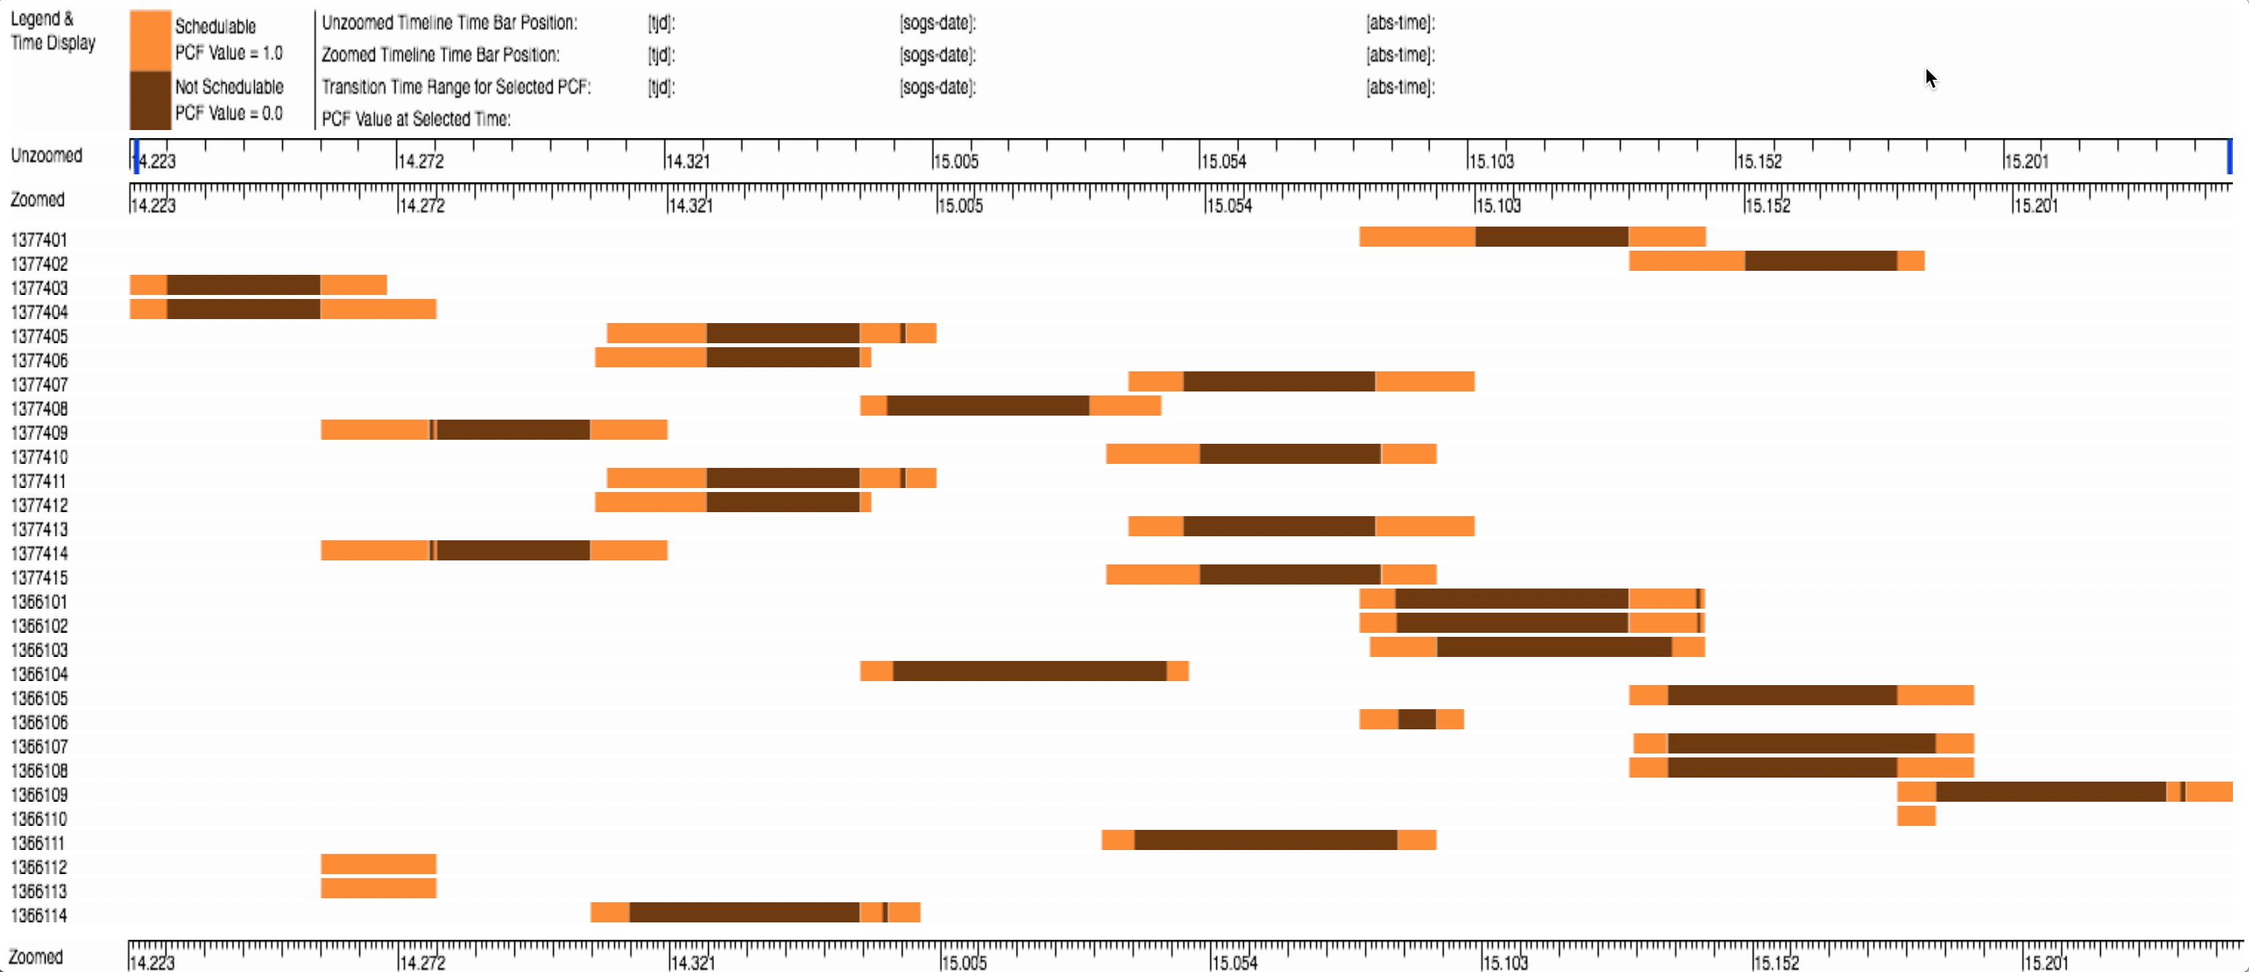
STScI Space Astronomy Summer Program August 7th, 2017

Slide 6

STScI Space Astronomy Summer Program August 7th, 2017

Slide 7
STScI Space Astronomy Summer Program August 7th, 2017

Slide 8

STScI Space Astronomy Summer Program August 7th, 2017

Slide 9
Future Work
Problem Report 88592 / 88592:
Implement Constraint Window Visualization for HST / JWST
Potential Improvements:
Incorporating both patterns and colors for colorblind users
Adapting to different time format inputs
Displaying multiple PCFs in a single line
Suggestions welcome!
STScI Space Astronomy Summer Program August 7th, 2017

Slide 10
Acknowledgements
Mark Giuliano
Iva Momcheva
Lou Strolger
John Debes
Bruce Seely
SPIKE Developers
SPIKE Users
Space Astronomy Summer Program
Space Telescope Science Institute
Live and Webcast Audiences !
STScI Space Astronomy Summer Program August 7th, 2017

Slide 11
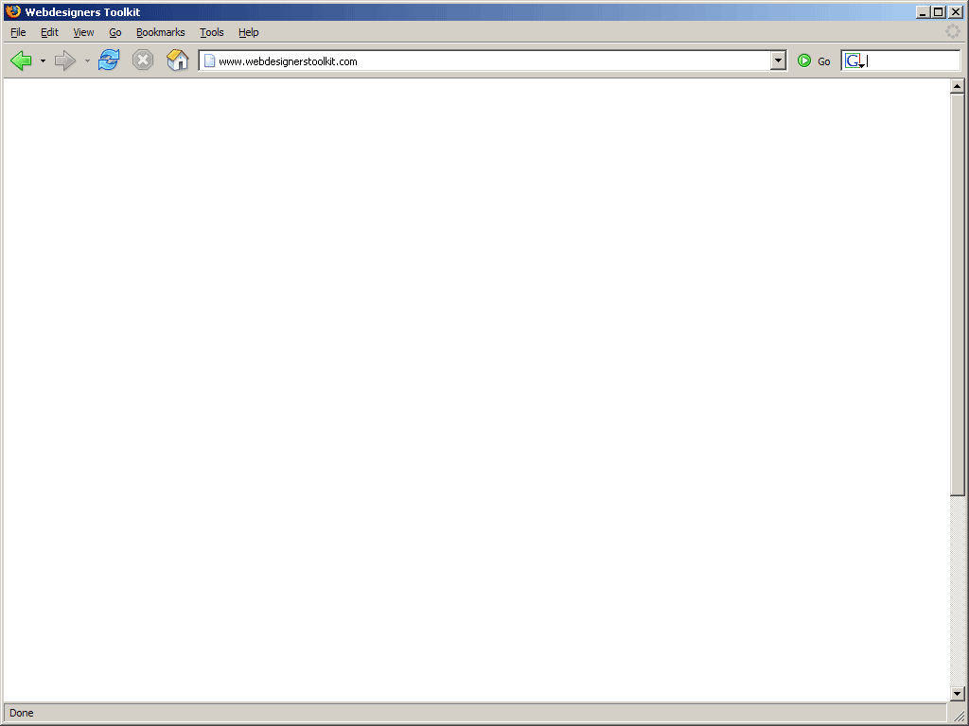
Internal Architecture
Piecewise Constant Function
(LISP Data Structure)
SPIKE (LISP)
Generic
HTML File
(JavaScript)
HST
JWST
STScI Space Astronomy Summer Program August 7th, 2017

